Slide 1


ELEL 5882M
19th Weekly Report
06/03/2024
Junnan Liu
201715540
el23jl2@leeds.ac.uk

Slide 2
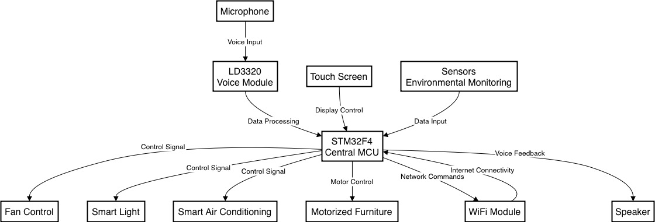
BLOCK DIAGRAM

Slide 3
COMPONENTS
VOICE MODULE: LD3320
MICROCONTROLLER:NUCLEO-STM32F446RE
TEMPERATURE AND HUDIMITY SENSOR: DHT20
SMOKE SENSOR: MQ-2
WIFI MODULE: ESP8266
SERIOR SCREEN: TJC1060X570_011C_I
Notes:
Based on the block diagram, here are the specific models of each component:

Slide 4
Task Name | Start Date | End Date | Duration (Days) | Days Complete | Days Remaining | Percent Complete
Read about the project (literature review) | 2023/12/9 | 2023/12/24 | 16 | 15.00 | 0.00 | 100%
Select a suitable voice-controlled system and study | 2023/12/19 | 2024/1/28 | 41 | 40.00 | 0.00 | 100%
Select and purchase components | 2024/1/29 | 2024/2/11 | 14 | 13.00 | 0.00 | 100%
Write the code of basic component | 2024/2/12 | 2024/2/25 | 14 | 3.90 | 9.10 | 30%
Write basic code of voice-control system | 2024/2/26 | 2024/3/27 | 31 | 0.00 | 30.00 | 0%
Write basic code of WIFI module and screen | 2024/3/28 | 2024/4/27 | 31 | 0.00 | 30.00 | 0%
Implementation and testing | 2024/4/28 | 2024/5/18 | 21 | 0.00 | 20.00 | 0%
Write the final project | 2024/5/19 | 2024/6/18 | 31 | 0.00 | 30.00 | 0%
Preparing for the presentation | 2024/6/19 | 2024/8/8 | 51 | 0.00 | 50.00 | 0%
Presentation and report submission | 2024/8/14 | 2024/9/1 | 19 | 0.00 | 18.00 | 0%
GANTT
Notes:
Below is the Gantt chart I originally planned, and everything is proceeding on schedule according to the plan.

Slide 5
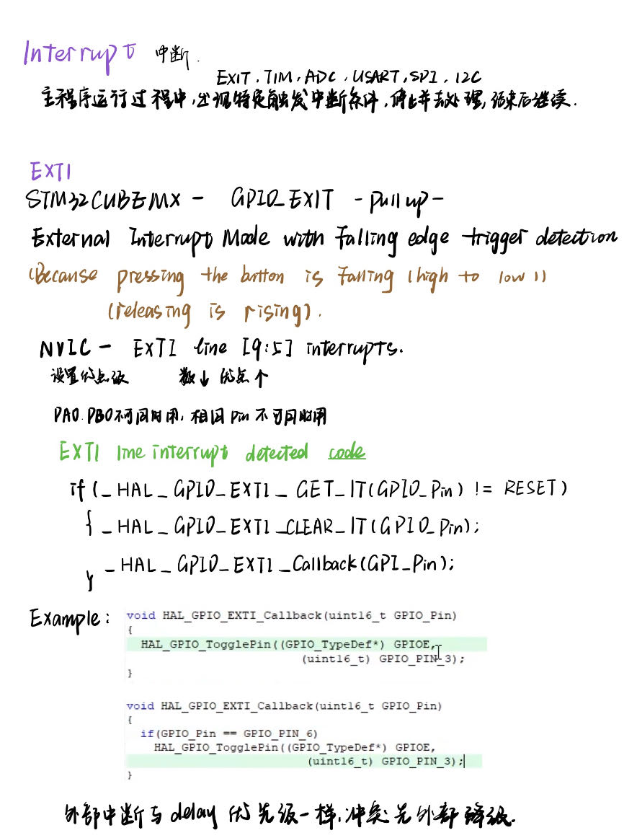
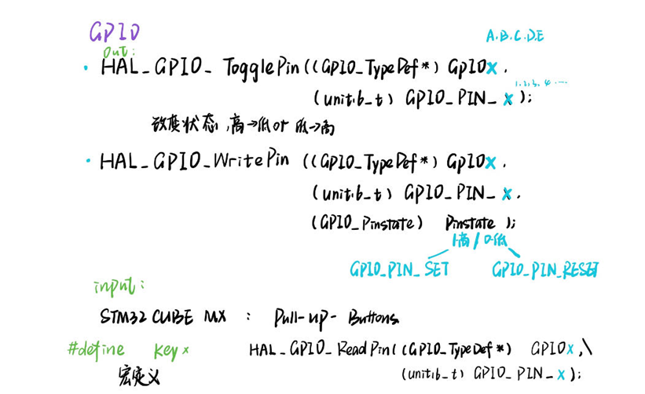
STUDY NOTES
Notes:
These are my study notes, covering the basics of GPIO and interrupt function code.

Slide 6
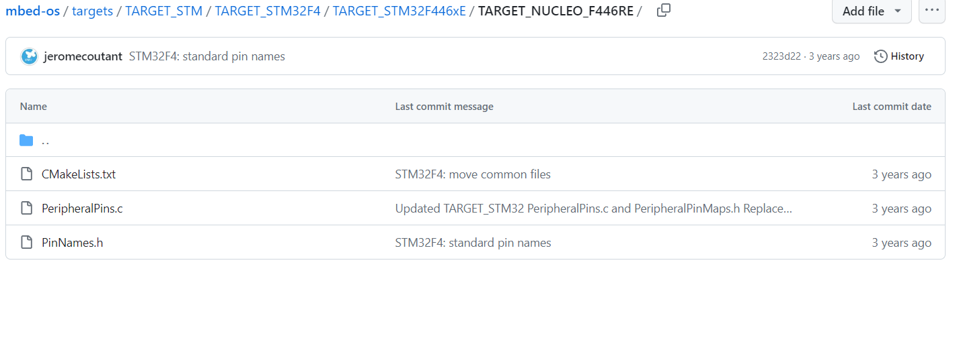
Confirm pin wiring
ACCORDING TO :
and DATASHEETS of components.

Slide 7
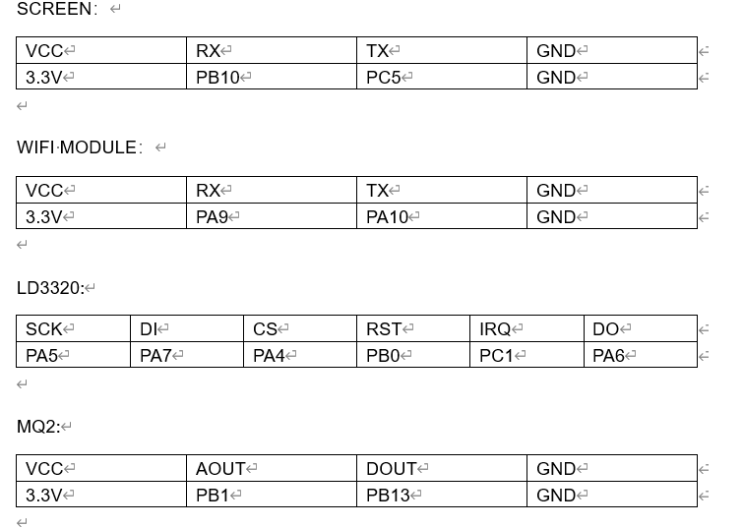
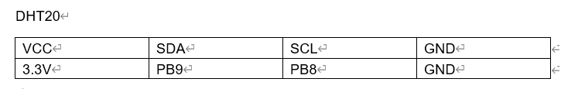
Confirm pin wiring
LIGHT: PC6
AIR CONDITIONING: PA12
FAN CONTROLLER: PA11
OTHER FURNITURE: PB2

Slide 8
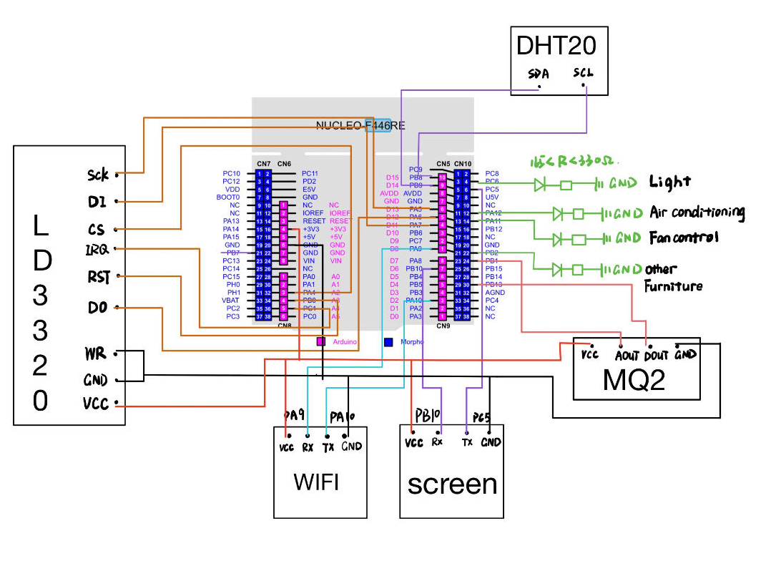
Confirm pin wiring
Notes:
This slide shows the wiring diagram I created, detailing how each device's pins are connected to the NUCLEO board based on my block diagram.

Slide 9
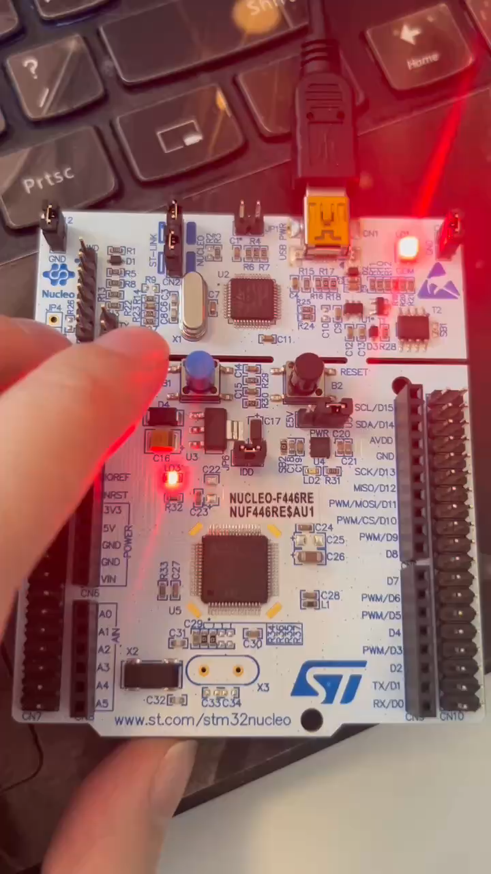
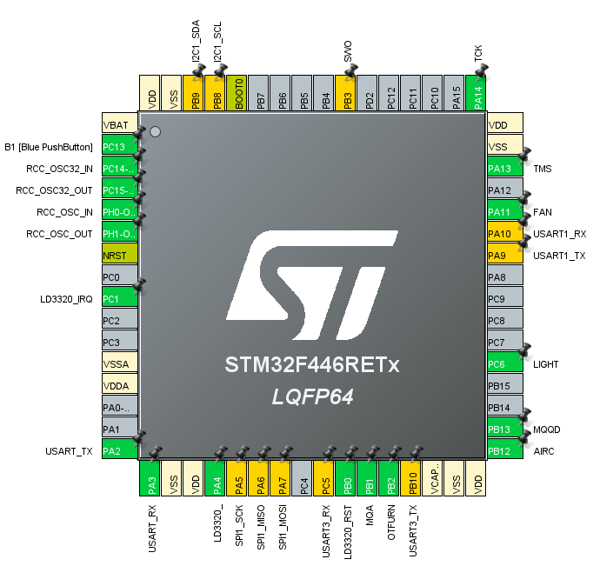
Pin overview in STM32CUBEMX

Slide 10
PLAN NEXT WEEK
Set up the configuration
for each pin accordingly.
Complete interrupt
01
03
02
04
Complete the clock configuration
Complete Timer

